Slide 1

UtilityBot
A Modular Chat-Based Multi-Tool Program

Slide 2
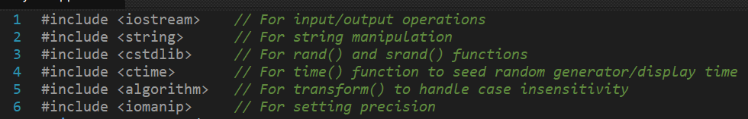
Program Overview
UtilityBot is an extensible console application that integrates practical tools through a conversational interface. Designed for easy feature expansion, it currently offers core utilities accessible via text/numeric commands.
Libraries Used:

Slide 3
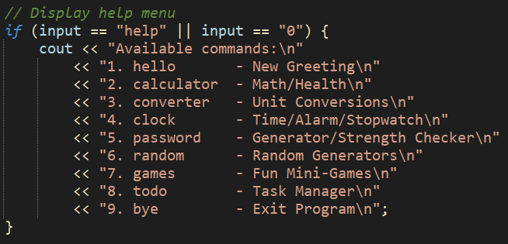
Feature Categories

Slide 4

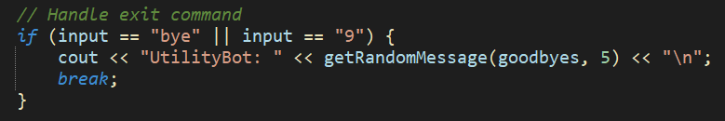
Core Interaction Elements
Greeting System: Greets the User upon starting the program using 5 different pre-defined messages randomly.
Exit Protocol: Breaks from the main body after giving a random pre-defined goodbye message when command “bye” or “9” is executed, hence exiting the program.

Slide 5
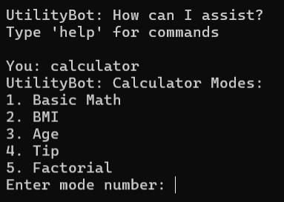
Calculator System
Mathematical & Analytical Tools
Basic Math Handles +, -, ×, ÷ operations with error checking
BMI Calculator Computes Body Mass Index with WHO health categories
Age Calculator Determines exact age using system date
Tip Calculator Calculates gratuity percentages
Factorial Generator Computes factorial values

Slide 6
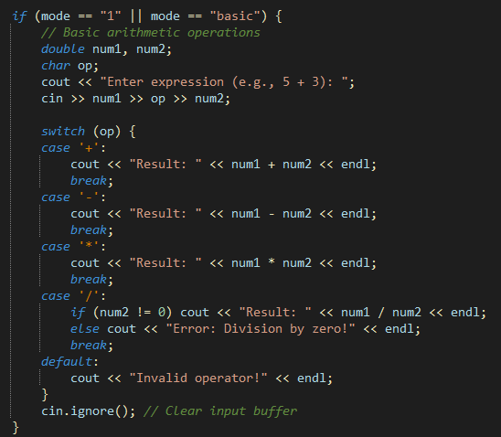
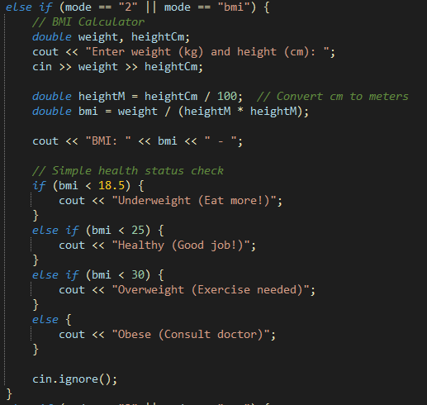
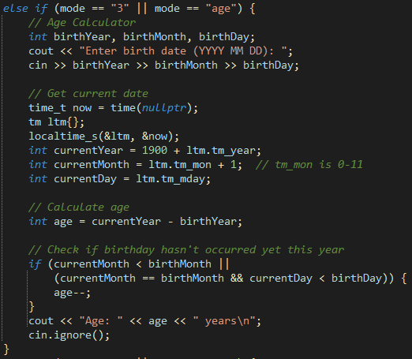
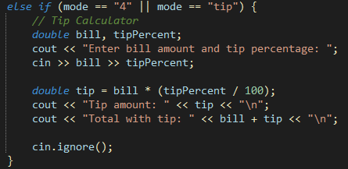
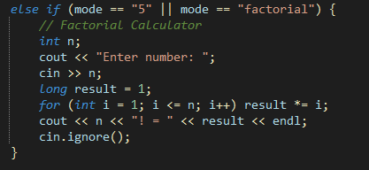

Slide 7
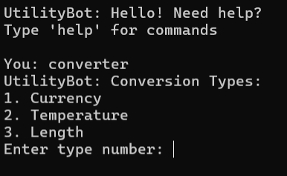
Unit Converter
Measurement Translation
Currency Converter Supports 7 currencies with USD intermediary conversion
Temperature Accurate °C ↔ °F translations
Length Meters ↔ Feet conversions

Slide 8
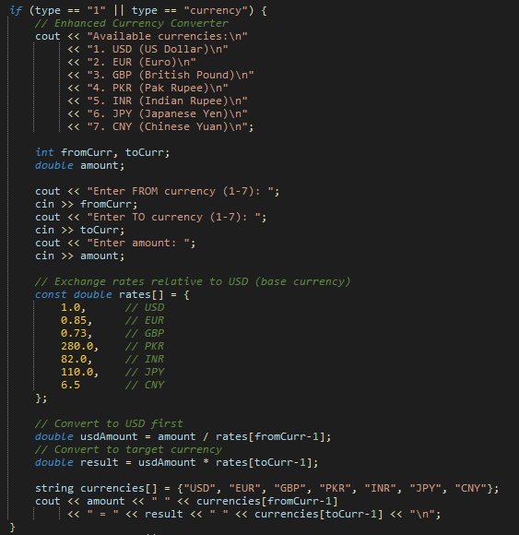
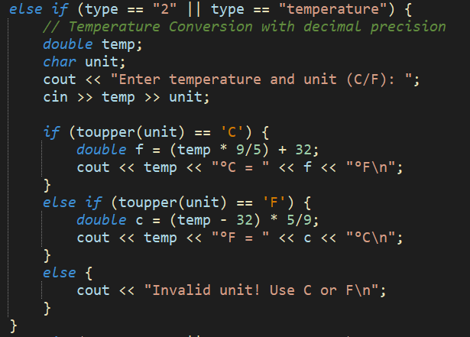
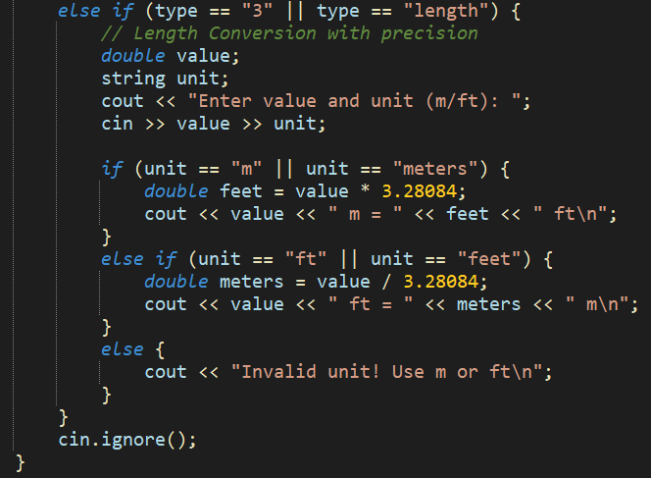

Slide 9
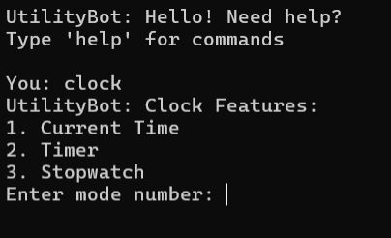
Clock Suite
Time Management
Live Time Display Shows current system time
Countdown Timer Customizable alert system
Stopwatch Lap tracking with start/stop control

Slide 10
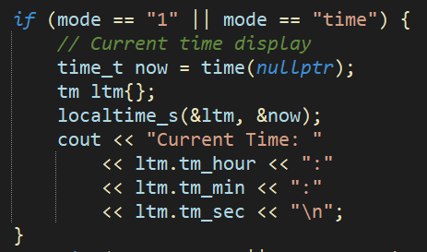
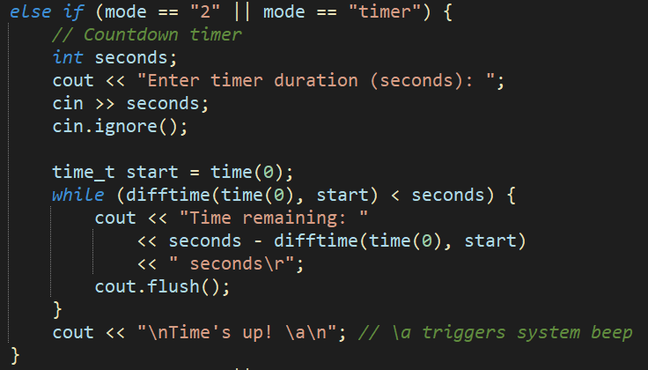
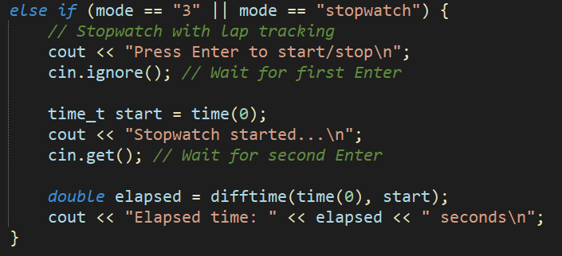

Slide 11
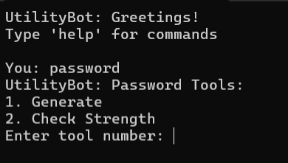
Password Manager
Security Tools
Generator Creates secure random passwords (8-50 chars)
Strength Checker Evaluates security on 5 criteria, And gives feedback on how to make your password stronger

Slide 12
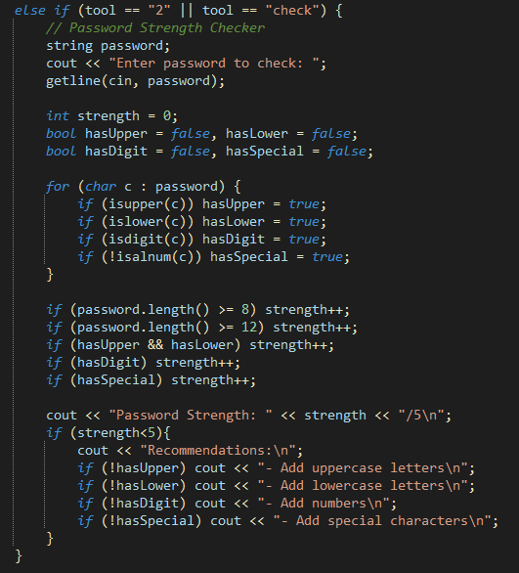
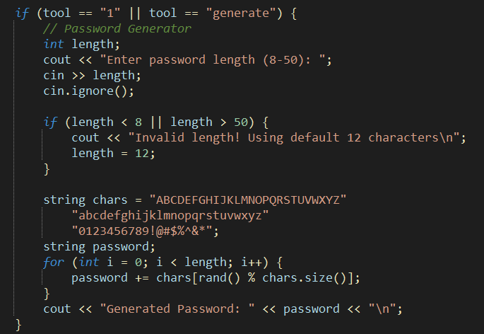

Slide 13
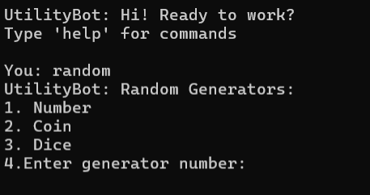
Random Generator
Probability Systems
Number Generator Custom range outputs
Coin Flip Simulates heads/tails
Dice Roll Digital 6-sided die

Slide 14
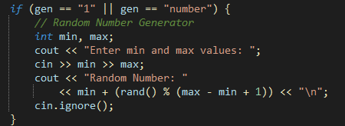



Slide 15
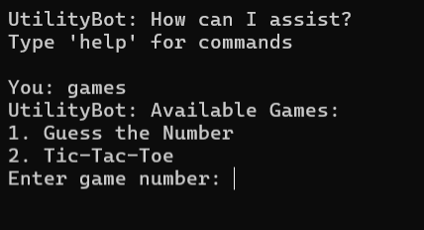
Game Collection
Entertainment Modules
Number Guesser 1-100 guessing with attempt counter
Tic-Tac-Toe AI opponent with win detection

Slide 16
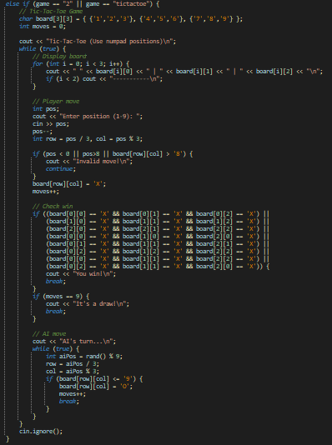
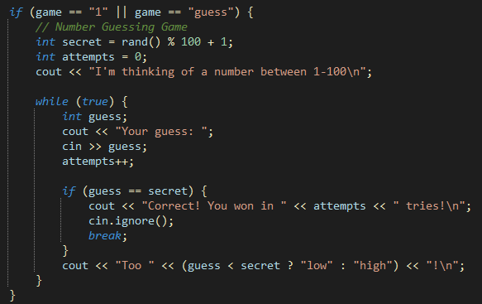

Slide 17
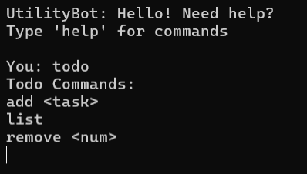
Task Organizer
Productivity Tool
Add Tasks Simple text entry
List Manager Numbered task display
Remove Function Position-based deletion

Slide 18
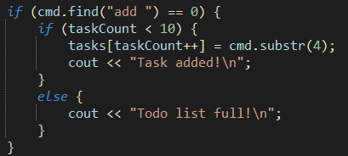
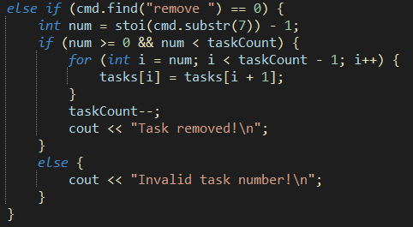
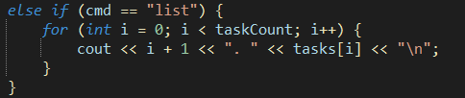

Slide 19
Expansion Framework
UtilityBot's modular design allows effortless feature additions:
Existing Feature | Expansion Opportunities
Calculator | Add calorie/loan calculators
Converter | Support volume/energy/weight units
Games | Include puzzles/trivia
Tasks | Add priority levels/due dates

Slide 20
Thank You
Submitted By:
Taha Khalid F2024266524
Muhammad Umer F2024266504
Talal Ahmad F2024266521

